Slide 1
Analytics Roadmap to Impact
Consulting in Data Science
Greg Green, PhD

Slide 2
The Business Problem & Value
Model Development & Insight
Data Universe
Insight to Action
Adopt & Implement

Slide 3
Business Problem & Value
Section 1

Slide 4
Business Problem and Value Creation
The Business Problem & Value
Data Universe
Model Development & Insight
Insight to Action
Adopt & Implement
Focus on the right business problem is not as easy as it seems on the surface. Key questions that help to resolve to the core problem addressable by your consulting team for maximum impact

Slide 5
Business Problem and Value Creation
The Business Problem & Value
Data Universe
Model Development & Insight
Insight to Action
Adopt & Implement
Challenge
Economic
Barriers
Gaps
Analytics
Influence
What are the challenges faced by the business today?
What are the economic levers for impact?
What are the barriers in play that stop us from simply resolving the situation?
What information gap, if we could address it, would influence each economic lever?
What approach matches the problem best – descriptive, predictive, prescriptive?
Does problem posed by client require refinement, breakdown, expansion, pivot from symptom to root cause, from incremental to breakthrough?

Slide 6
SMART Goals – Exercise: Bring a Problem
SMART = Specific – Measurable – Actionable – Relevant – Timebound
The primary goal of this framework is the refinement of goals to make them substantively more action oriented. Typically, every aspect of a goal provided by a client, boss or colleague can be refine and improved by applying this framework in a discussion or debate with your team.
Examples:

Slide 7
SMART Goals – Examples
Specific
Measurable:
Relevant:
Timebound:
Increase Revenue vs. Increase Revenue by 12-15% within the U.S., >20% in EMEA, >30% in APAC
Improve Marketing Performance vs. Increase KPIs by 20%, Audience size (from 5M to 6M), CTR (from 1% to 1.2%), ROI from 200% to 240%
When negotiating a refined goal, ensure your Specific, Actionable and Measurable version of the goal is still achieving the intent of the original
Drive to improvement on KPIs in test markets within 60 days. Ensure timebound is 90 days or less for ideal pace
Actionable
Change approach to 1:1 with unique message driven by predictive model vs. blanket creative and message

Slide 8
SMART Goals – Example Problems
Goals (Prior to SMART application)
1) Build a Consumer Offer Model that is Better than Existing Logistic Regression for Verizon
2) Turn-around Declining Revenue on Flagship Product Line for 3M
3) Increase volume for consumer product brand without discounting price
4) Increase forecast accuracy of revenue and earnings per share for portfolio companies
5) Increase economic impact of data science team
Or – Bring a goal from work and attempt to upgrade the quality, achievability and time to impact of that goal using the SMART framework.

Slide 9
Data Universe
Section 2

Slide 10
Data Universe
Data Universe
The Business Problem & Value
Model Development & Insight
Insight to Action
Adopt & Implement
Data available to address a situation can extend beyond obvious sources. In fact, the data immediately available may lack structure suitable for modeling and may violate key assumptions of statistical approaches.
In many situations, the problem posed has remained unsolved due to a lack of expanded thinking regarding the universe of data.

Slide 11
Data Universe – Key Questions
Data Universe
The Business Problem & Value
Model Development & Insight
Insight to Action
Adopt & Implement
Expanding our data universe – dramatically!
Have we considered both internal and external data sources?
Do we need to design an experiment to derive robust model coefficients?
Have we considered competitive intelligence as well as competitive data/benchmarks?
Should we purchase data to augment “free” sources and improve performance?
What research and data methods have been utilized and are any methods untapped to augment our data sources?
Are we including: primary, secondary, qualitative, quantitative, behavioral, demographic/psychographic, attitudinal, intent, location, IOT, device, credit, health, lifestyle and product usage?

Slide 12




Marketing Example
Company
Data Exchange
Agency/Media Partner
Historical Data
Marketing Offers
Response data
Analytics Opportunities: Descriptive, Predictive Models, Recommendation Engine – But without the data, there is significantly reduced opportunity
Economic Value: Utilize Prior Data, Monetize and Fund Storage, Team, Projects
Ensure Agency/Vendor is Sharing all Data
Critical to Receive and Optimize Response Data
Privacy Policy: Transparency for Data Use
Ref: “From Big Data to Big Profits” Russell Walker, Oxford University Press 2015

Slide 13
Model Development and Insight
Section 3

Slide 14
Big Data Sources
Data Dimensions Increasing in Size of Source:
What other data characteristics can be used to dimensionalize and size data assets?
Type
Time
Consumer
Numbers
Text
Video
Complex Content
Location
Aggregated Historical
Annual
Quarterly
Hourly
Granular Real-time
Attitude
Motivation
Intent
Advocacy
Purchase Behavior
Data comes in a wide variety of sizes, dimensions, packages, and structures. Some say that unstructured data is data just waiting for a structure. Also, data has many levels of granularity, degrees of quality, and challenges that require innovative thinking before it is possible to extract value.

Slide 15
Model Development and Insight
Model Development & Insight
The Business Problem & Value
Data Universe
Insight to Action
Adopt & Implement
Initial Development:
Visualization:
Influence:
Once the business problem and the data sources are mostly resolved, model development and insight acquisition begins.
The activation of the model results in the business can be easily visualized through gains tables and what is called a confusion matrix.
Economically valuing a model thru simulation can also be a powerful motivator to decision makers to begin the pivot from analysis to action oriented discussions.

Slide 16
Model Development and Insight
Model Development
& Insight
The Business Problem & Value
Data Universe
Insight to Action
Adopt & Implement
Model selection and insight development
Model sensitivity? (data, assumptions and gaps)
Which techniques will produce the best performance?
What is the economic baseline of “no model/no action” (Business as Usual – BAU) vs. activation?
Performance on training data and “out of sample” - overfit?
What insights relate to the Economic Barriers and Levers?
What is the simplest model vs. most complex – worth it?

Slide 17
Model Development Maturity
Organizational Analytics Maturity – (Table 6-2)
1 – Impaired – Limited Insights, Knowledge allergic
2 – Localized – Autonomous teams and pockets of success
3 – Aspirational – Coordinated and Organizationally growing
4 – Analytical Company – Programs, Integrated Systems, Applications and Capabilities
5 – Analytical Competitor – Deep Strategic Insights, Continuous Improvement
Ref: ”Competing on Analytics”, Thomas Davenport, Jeanne Harris 2007

Slide 18
Insight to Action
Section 4

Slide 19
Insight to Action (Action Orientation)
The Business Problem & Value
Data Universe
Insight to Action
Adopt & Implement
Model Development & Insight
Creating Value:
Taking Action:
Overcoming Resistance:
Once a model has been built, tested and evaluated we are at the beginning of the true value creation phase of the journey. Gartner says 94% of AI projects fail prior to implementation.
The action orientation of the team and the activation of the model in the business is difficult and requires significant effort by the consulting team.
In this phase we meet resistance and sometimes complacency. The questions below help focus toward activation and full monetization, capturing the potential of the model in the business.

Slide 20
Insight to Action (Action Orientation)
The Business Problem & Value
Data Universe
Model Development & Insight
Insight to Action
Adopt & Implement
Build a Compelling and Urgent Case for Change
What barriers and economic levers are in play?
What are the costs of integration of the new model?
What is the full value (Cost reduction and revenue enhancement)?
What is the P&L case for change regarding each application?
Are their strategic reasons beyond the economic levers for implementation?
(Competitive advantage, consumer experience, cost reduction, revenue lift, market share, or new audience growth?)

Slide 21
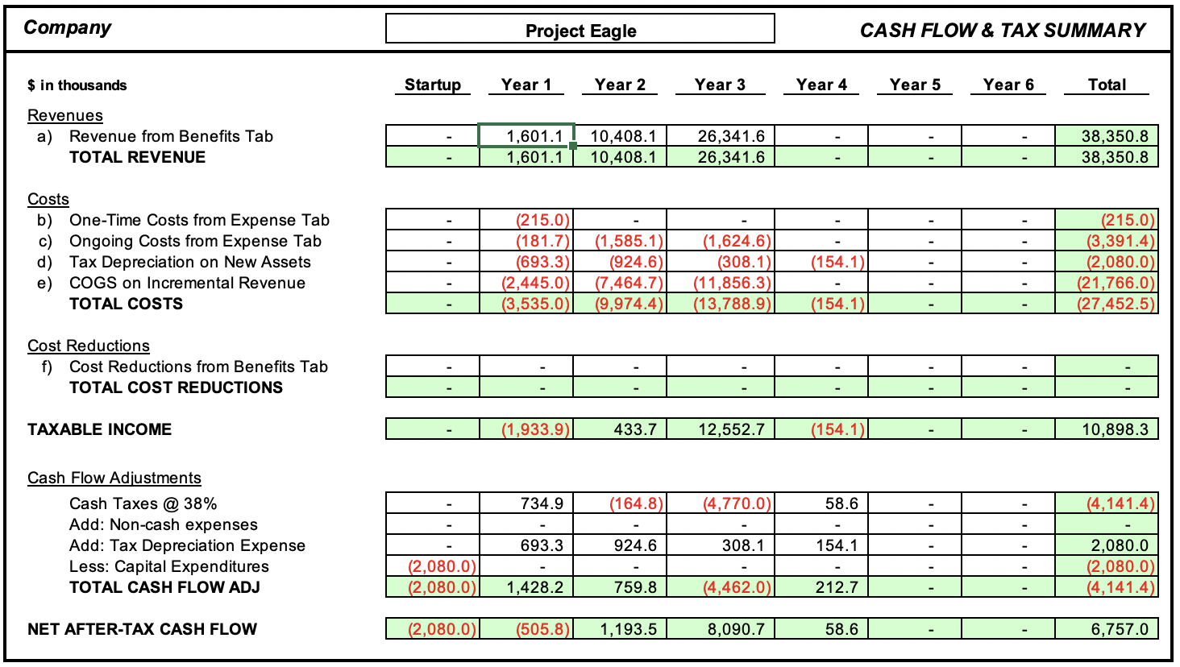
Insight to Action Business Case
Example:
Template from a $5B media company, mature in evaluating investments for new digital products and implementing analytic systems.

Slide 22
Adopt and Implement
Section 5

Slide 23
Adoption and Implementation
Adopt & Implement
The Business Problem & Value
Data Universe
Model Development & Insight
Insight to Action
To fully implement a new AI system it takes more than a model build, case for change and a decision by the client – often this is just the beginning.
Implementation of the new system requires focus and effort to realize the full economic potential.
Including:
workflow changes, support from management
data and system integrations, changes to incentive systems including pricing, compensation, bonuses and promotions
adoption by front-line workers, customer communications, marketing, … and more…

Slide 24
Adoption and Implementation
Adopt & Implement
The Business Problem & Value
Data Universe
Model Development & Insight
Insight to Action
Questions to help the adoption phase:
Which customers, divisions and teams are impacted by the new intelligent solution?
Will there be training or communication needs?
Are there incentive conflicts? Compensation issues, manual or skilled labor changes that impact motivation, labor contracts?
How will we measure and refine? Will there be a feedback loop?
Who benefits from the cost reduction and increased revenue?
And how is value attributed to the Data Science team to obtain investments?
What about systems, organization, or process changes needed?

Slide 25
Adoption and Full Scale Examples
Conversion Optimizer – Google tool integrated as a fully new way to purchase search ads and keywords
Recommendation Engine on an Ecommerce Site – From suggestions to full integration with shopping cart, we are seeing the evolution of the monetization of recommendation engines
Audience Targeting – Moving from locating and targeting the most interested and engaged buyers with the most relevant messages and offers, to a bid management engine that allows 1000s of buyers to participate in competition in real time for audiences.
Image Recognition for BevCo – Moving from a model that matches images with beverage brands to a tool that processes pictures and videos from a mobile app for automated beer tap counting per location.

Slide 26
References:
Competing On Analytics: The New Science of Winning, Davenport and Harris, Harvard Business School, 2007
From Big Data to Big Profits: Success with Data and Analytics, Russell Walker 2015
The Management Consultant Toolkit 2019, theteam@ExpertToolkit

Slide 27
Week 5: Model Development and Insights

Slide 28
Model Development and Insight
Model Development & Insight
The Business Problem & Value
Data Universe
Insight to Action
Adopt & Implement
Initial Development:
Visualization:
Influence:
Once the business problem and the data sources are mostly resolved, model development and insight acquisition begins.
The activation of the model results in the business can be easily visualized through gains tables and what is called a confusion matrix.
Economically valuing a model thru simulation can also be a powerful motivator to decision makers to begin the pivot from analysis to action oriented discussions.

Slide 29
Model Development and Insight
Model Development & Insight
The Business Problem & Value
Data Universe
Insight to Action
Adopt & Implement
Model selection and insight development
Model sensitivity? (data, assumptions and gaps)
Which techniques will produce the best performance?
What is the economic baseline of “no model/no action” (Business as Usual – BAU) vs. activation?
Performance on training data and “out of sample” - overfit?
What insights relate to the Economic “Barriers and Levers”?
What is the simplest model vs. most complex – worth it?

Slide 30
Model Case Study – Team Project (3-4 people per team)
LPGA Golfer Performance Data Provided
Purpose: Develop approach that identifies primary characteristics that are predictive or the capture of prize winnings (tournament wins). Use these features as coaching focus areas for golfers, presenting each golfer with the top 3-5 priorities to improve their game.
Application: Golfer enters their performance into a mobile application, the app rank orders the priority focus for the golfer to increase their odds of winning.
Challenge: Approach this exercise utilizing your current knowledge of descriptive, predictive and prescriptive analytics.
Objective: Utilizing data provided in this example perform the following tasks:
Define Business Problem
Explore Data
Build and Test Model
Build Case for Change (Economics)
Extra Credit – Propose Full Scale Version for Consumers

Slide 31
LPGA Golf Professional Data (See Link in Canvas)
Questions to consider:
Are there any data anomalies?
How would you split the data to train vs. test the model developed?
Is the answer always the same for all golfers or does performance matter, driving differential recommendations?
Is there a way to answer the questions without using advanced analytics – simply descriptive statistics and rankings?
What feature development and pre-processing of data do you recommend?
What alternative modeling approaches are possible?

Slide 32
Week 5 - Pitfalls in Projects

Slide 33
Framework for Pitfalls - CRAFT
Context – What problem and why important to ensure success
Research Design – Right design and data sets stage
Analytics/Technology – Model selection and approach for efficiency, effectiveness
Focus – Help client and team focus with great visuals and communication
Take Action – Create value by implementing the model at scale
C Client Context | R Research Design | A Analytics and Technology | F Focus, Visuals, Communication | T Take Action to Create Value

Slide 34


New Product Testing
Context: New product testing. Merchandisers get recognition for finding new fashion that scales to a popular trend…
What does San Francisco have in common with Columbus Ohio when it comes to fashion?
C Client Context | R Research Design | A Analytics and Technology | F Focus, Visuals, Communication | T Take Action to Create Value

Slide 35

Data Quality and Sampling
Reference Text: William G. Cochran, Sampling Techniques
Is a census better than sampling? Which technique should I use? (Stratified, PPS?)
How important are missing values? Is a zero any different than a missing value?
Data quality depends on the context, question, technique - it is your foundation
Big Data – Who has it, how big is it...will you ever get your hands on it?
Does the data ever satisfy the assumptions of the analytic techniques?
Data surfing, how important is it...buy the product, call the call center, use the product, talk to sales, customers, data modelers, and data gatherers…
C Client Context | R Research Design | A Analytics and Technology | F Focus, Visuals, Communication | T Take Action to Create Value

Slide 36

Forecasting Models and Inventory
Model Accuracy Level Ideal but Problem Growing…
Revenue and Sales for National Chain - 98% plus
But our regression model has an R-Square of over .95 and is 98% accurate - how can we be in trouble?
Is a missing value the same as “0” and when is 0<>0?
How can data quality be 100% and yet be very problematic for the Analyst? Quality is in the eye of the use case...not a “truth”!
The power of imputed values - a lesson from sonar signal processing.
C Client Context | R Research Design | A Analytics and Technology | F Focus, Visuals, Communication | T Take Action to Create Value

Slide 37
Multi-Level Forecasting
Sometimes it is more important to understand the error in the model - especially if managing inventory, costs, impressions, performance.
Geo\Timing 6 months 1 Month Opening, Mid-Promo
Global 5%* 3% 2% 1%
Regional 20% 5% 3% 3%
Local 40% 20% 10% 5%
Store 75% 50% 20% 10%
* +/- % Error provided by Model Development team at 80% Confidence
C Client Context | R Research Design | A Analytics and Technology | F Focus, Visuals, Communication | T Take Action to Create Value

Slide 38


A/B Testing - Refinement
Refine - Incrementally improve from a workable creative ad/website experience
Redefine - Change things dramatically to find a break-through performance experience
Best solution
is missed
performance
Time
C Client Context | R Research Design | A Analytics and Technology | F Focus, Visuals, Communication | T Take Action to Create Value

Slide 39

Predictive Modeling
Why would my model be worse than random?
Context: Improve the financial performance of the audit teams - add a layer of predictive to random selection.
Dataset: 2 Million late payors (non-filers/stop filers) - how do I check data quality on huge volume?
Sampling Strategy - In/Out Sample 50K records for initial model build
Score hold out sample - assess performance of predictive model (lift over random selection)
Guess the most predictive variables? What assumptions in linear regression, if not true, could cause perfectly good models to perform worse than random (Negative lift)?
Which is the most powerful, GLM, Backwards or forwards regression techniques?

Slide 40

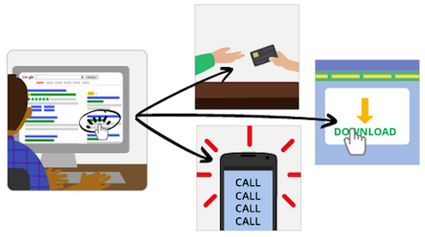

Optimizers
C Client Context | R Research Design | A Analytics and Technology | F Focus, Visuals, Communication | T Take Action to Create Value

Slide 41


Statistical Significance
What is the best significance test?
What is the best statistical test to use for website testing?
Which is important, statistical or business significance?
ROI - Gathering data for ROI decisions...know your thresholds for each client and stakeholder.
Will they care? Will it move the needle?
I can be absolutely sure things are different and still get a yawn...Need to pivot to economic value creation
C Client Context | R Research Design | A Analytics and Technology | F Focus, Visuals, Communication | T Take Action to Create Value

Slide 42

Technique Selection – Can this be Productized?
Sampling Techniques - Simple/Stratified Random, PPS, Representative
Variable Transformation, Reduction - Factor Analysis, PCA, EFA
Cluster Analysis, CHAID, Logistic Regression, NN, RF
ANOVA/MANOVA, A/B Test, Multivariate Testing
Qualitative/Quantitative Research - Focus Groups, Panels, Recruiting, On-line/Phone, Small/Large Samples
C Client Context | R Research Design | A Analytics and Technology | F Focus, Visuals, Communication | T Take Action to Create Value

Slide 43

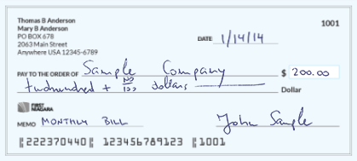
Value Creation
Cashing the check...
C Client Context | R Research Design | A Analytics and Technology | F Focus, Visuals, Communication | T Take Action to Create Value

Slide 44
Overview - What have I learned in 30 years...
Data Quality, Outliers and Sampling Theory - Everything depends on the data
New Product Testing – False positives happen...sometimes accidentally
Multi-Level Forecasting - Timing is everything, understanding and using error
Predictive Modeling - Take care - it is possible to do worse than random
A/B Testing - Not all tests are created equal
Optimizers - Garbage in...don’t optimize for the wrong outcome
Statistical Significance and Analytic Techniques - It’s like getting an A on your mid-terms
Value Creation - Your paycheck depends on it

Slide 45
Greg Green, PhD
Education, Corporate and Client Experience
The Claremont Graduate University, PhD, Mathematics (Reliability and Statistics)
Hughes Aircraft, PwC, Digitas, Google, Harland Clarke Holdings, FourThirds, LLC
Clients/Business Partners - Citigroup, United Airlines, Coors, McDonalds, TransUnion, Bank of America, Verizon, IRS, 1-800-Contacts, GM, Google, Lityx, SocialDeviant
Current Role: Executive Director Analytics Programs, UCPE, The University of Chicago
Mission: “Empowering analytics professionals to deliver amazing outcomes”

Slide 46
Week 5 Deep Dive Into Mobile Data

Slide 47
Mobile Location Data
Examine New Data Source – Determine Potential Use cases

Slide 48
Making Data More Human
Move this exercise to Canvas:
https://www.ted.com/talks/jer_thorp_make_data_more_human/transcript?language=en
“By placing data into a human context, it gains meaning”
Discussion Challenges –
Identify 10 ways to make data more human and add breadth, depth and dimensionality to data
How does location data become more human when you add a retail grid with store meta data?
What season are we in while data is being gathered?
How does time of day matter when examining location data?
How granular is too granular when it comes to location?

Slide 49
Two versions of Mobile Location Data
Location Data is only the Beginning
With Just a Bit of Human Context
Https://myshadow.org/trace-my-shadow
Geolocation data points:
@42.3986041,-86.2995789,13z
@41.8902048,-87.6232163,17z
@41.6855638,-88.1731884,12z
@41.6852023,-88.3833334,10z
@40.7765233,-112.0605693,11z
41°46'09.8"N 88°09'29.8"W
Vacation Spot on Lake Michigan
Work Downtown 455 – no recent activity (WFH)
Fox River Trailhead
Daughter at work as a middle school teacher
Newly Married Son buys house in Salt Lake City
Downtown Naperville

Slide 50
What other data is needed to augment location data for context to begin to build?
Duration in Location
Time of day/night
Day of week
Related Devices
Speed (Walk, Run, Drive)
Activity (Social Media, Text/Email/Slack, Games, News)
8 hours per day (work/home)
day/night (Work/Home)
Day of week (Work/Home)
Related Devices (Leisure, Family, Social)
Speed (Walk, Run, Drive, Commute)
Work/Leisure/Escape

Slide 51
Additional Features Needed?
Added Sources
Upgraded Features
Paths
Composite Scores (Financial, Risk)
Special Groups (Taxi/Uber, Delivery, Truck, Police)
Child, Mom, Commuter
Special Devices (Multi, Early Adopter, Old)
Home, Work, School, Grocery
Retail Stores (Type, Brand, Products, Restaurant, Big Box)
Points of Interest (Hotel, Attraction, Sports)
Census, Demo, Financial
Risk, Crime, Density
Commercial, Industrial, Residential

Slide 52
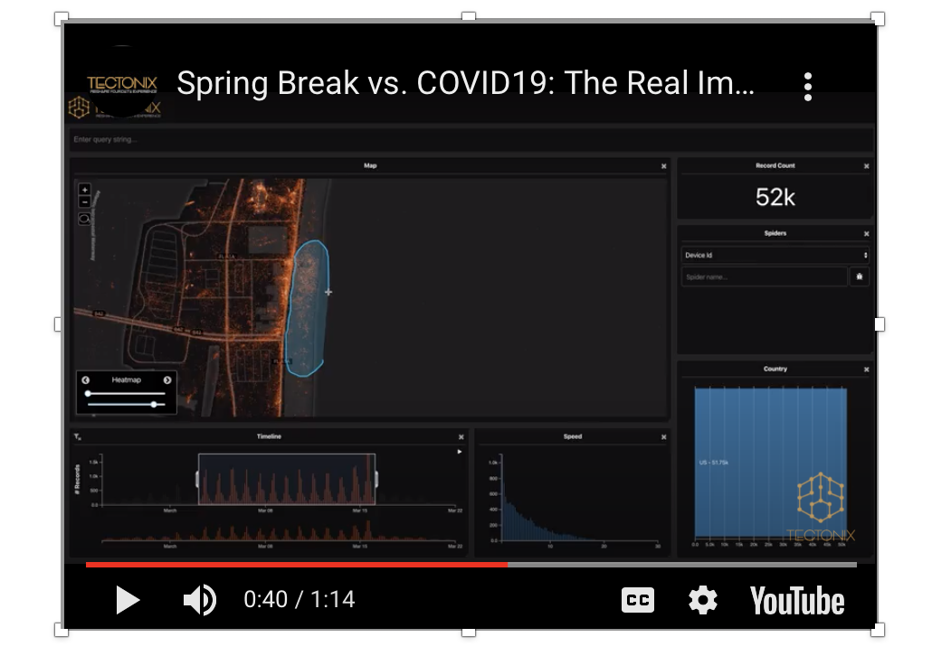
Visualizing Location – Springbreak
Video:
Mobile devices of beach-goers are selected and tracked in subsequent weeks to understand the potential spread of the virus post springbreak.

Slide 53

Video:
Mobile devices of beach-goers are selected and tracked in subsequent weeks to understand the potential spread of the virus post springbreak.

Slide 54
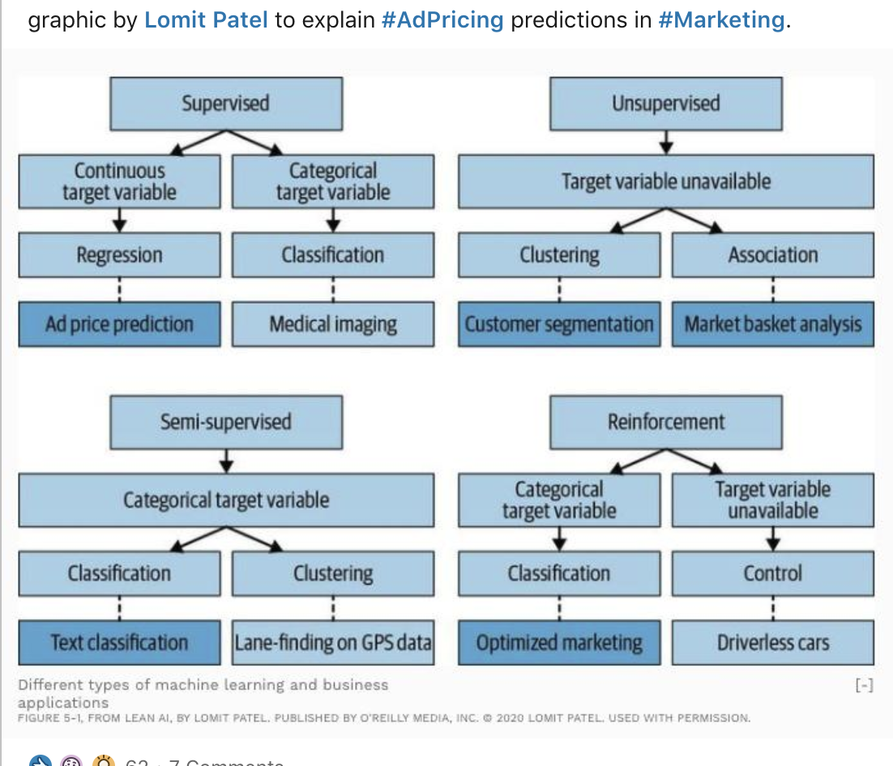
Develop, Train and Validate
Some types of AI Learning
Using Robust Location Data
Predict Intent to Purchase an Auto (Repair Visits, Maintenance, New/Used Car)
Develop Features of Shopping Behavior
Predict Based on Store Type Visits (Grocery, Clothing, Mall, Sporting Goods)
Frequent Diners, Mid-tier vs Luxury Restaurant vs Fast Food
Predict Higher Risk Car Insurance

Slide 55
Develop, Train and Validate
Managing Data to Train and Validate - Discussion
Random Split (50/50, 90/10)
Timing Split (Period 1-90/91-100, Month 1-22/23-24, Day 1-60/61-90)
Label Concentration (Over sample signal)
Outlier Detection, Influence and Sensitivity
Merge for Final Model Development to Utilize full data

Slide 56
Forecasting with Test Data – Discussion Examples:
Predict Intent to Purchase an Auto (Repair Visits, Maintenance, New/Used Car)
Develop Features of Shopping Behavior
Predict Based on Store Type Visits (Grocery, Clothing, Mall, Sporting Goods)
Frequent Diners, Mid-tier vs Luxury Restaurant vs Fast Food
Predict Higher Risk Car Insurance

Slide 57
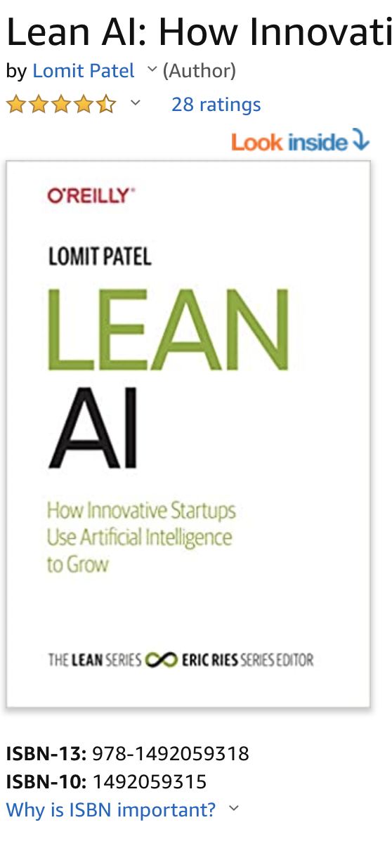
References
“Lean AI: How innovative startups use Artificial Intelligence to grow” by Lomit Patel

Slide 58
Wrap-up
?

